Slide 1
Predicting Medical Insurance Charges
-Mrugank Raut

Slide 2
Problem Statement
Health insurance is a type of insurance that covers medical expenses that arise due to an illness. These expenses could be related to hospitalisation costs, cost of medicines or doctor consultation fees. The main purpose of medical insurance is to receive the best medical care without any strain on your finances. Health insurance plans offer protection against high medical costs. It covers hospitalization expenses, day care procedures, domiciliary expenses, and ambulance charges, besides many others. Based on certain input features such as age , bmi,no of dependents ,smoker ,region medical insurance is calculated.

Slide 3
Dataset Overview
age: age of primary beneficiary
sex: insurance contractor gender, female, male
bmi: Body mass index, providing an understanding of body, weights that are relatively high or low relative to height, objective index of body weight (kg / m ^ 2) using the ratio of height to weight, ideally 18.5 to 24.9.
children: Number of children covered by health insurance / Number of dependents
smoker: Smoking
region: the beneficiary's residential area in the US, northeast, southeast, southwest, northwest.
charges: Individual medical costs billed by health insurance

Slide 4
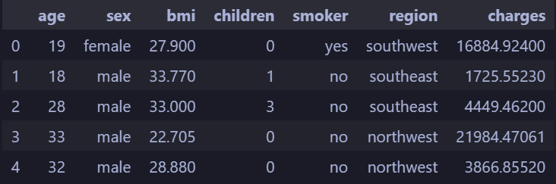
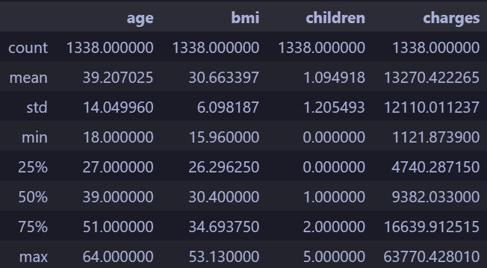
Data Loading & Initial Exploration

Slide 5
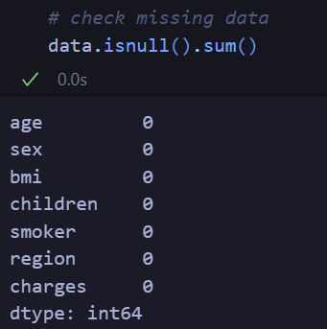
Handling Missing Data
No Missing Value is found

Slide 6
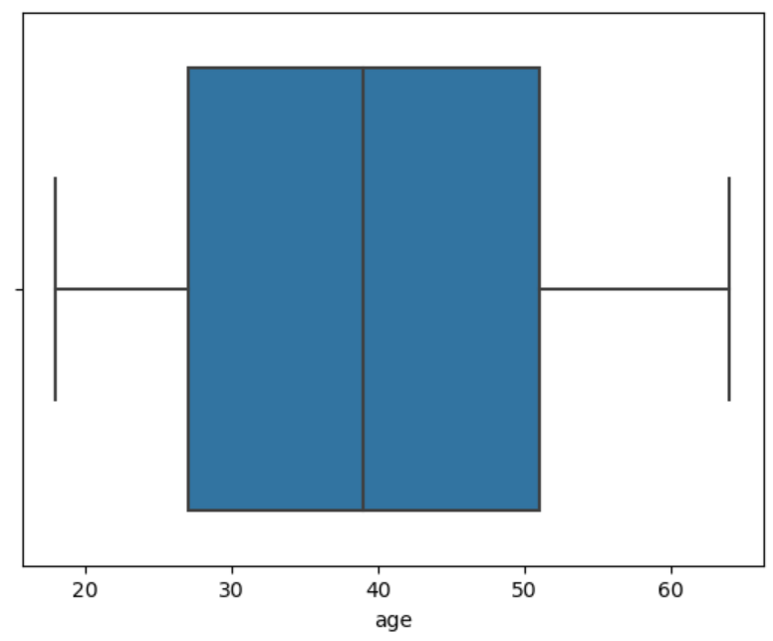
Handling Outliers - data[‘age’]
All values are seem to be in IQR range

Slide 7
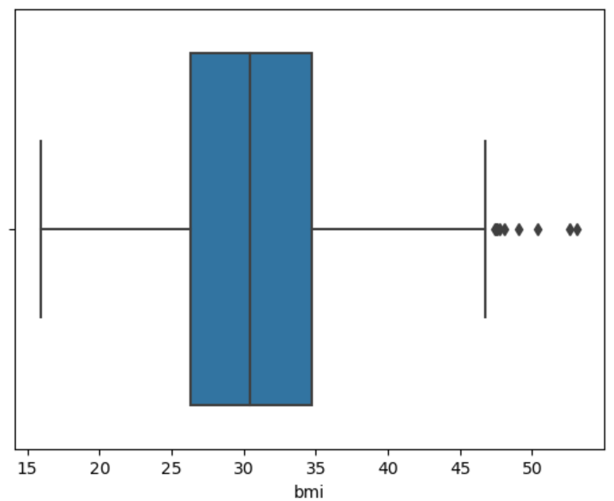
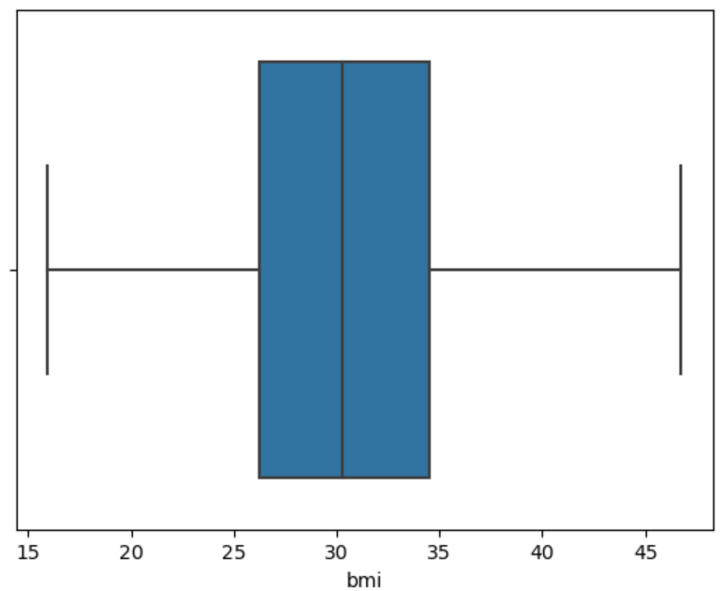
Handling Outliers - data[‘bmi’]
Outliers were detected using IQR method and removed

Slide 8
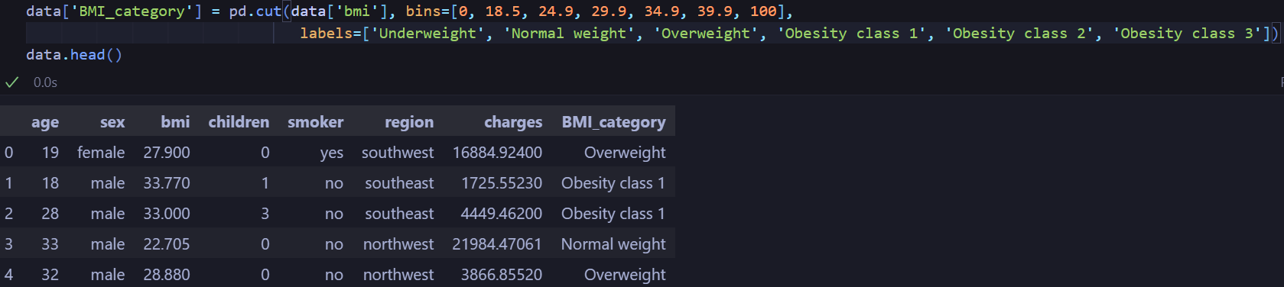
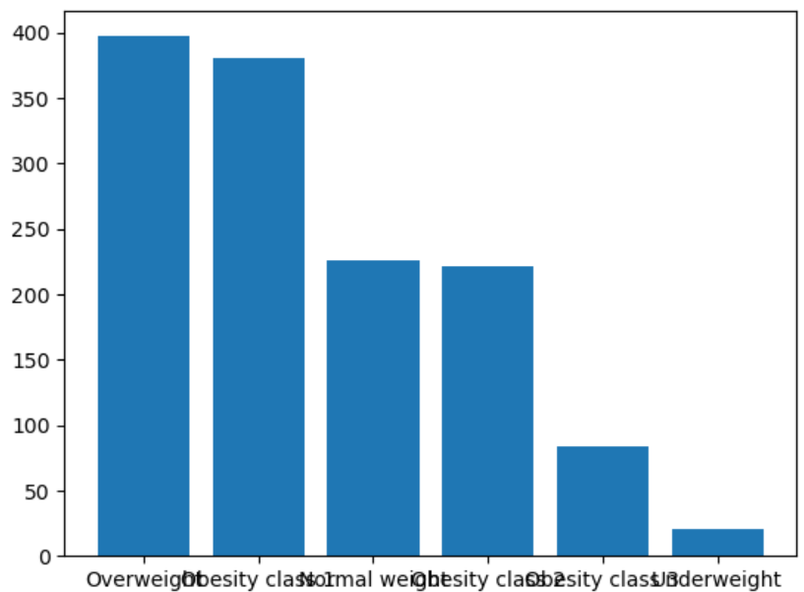
Feature Engineering - BMI Category

Slide 9
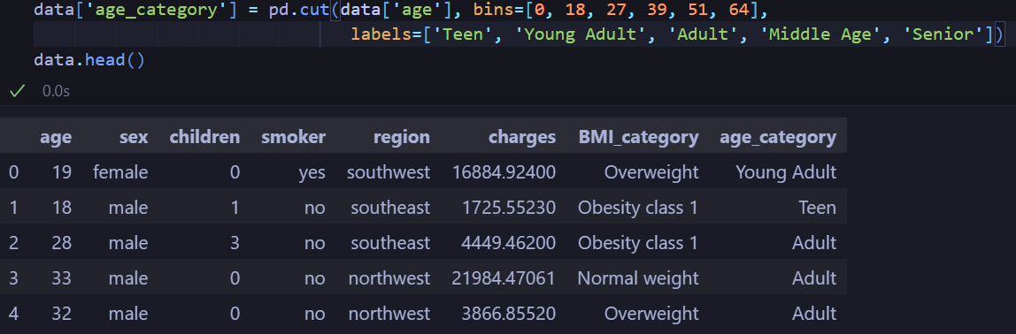
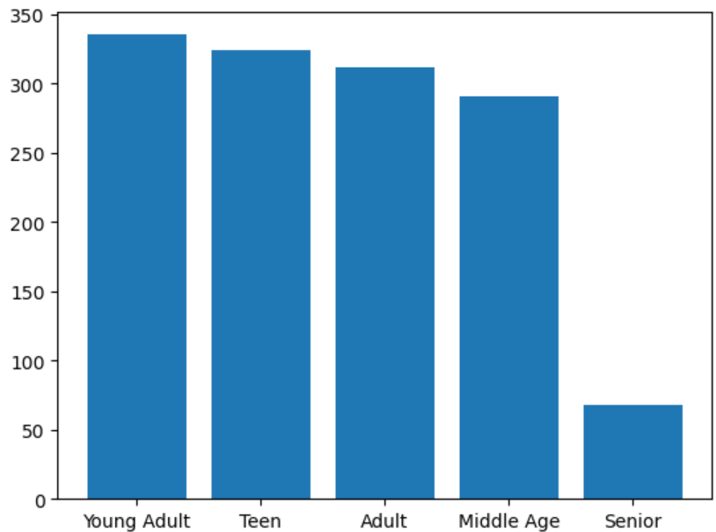
Feature Engineering - Age Category

Slide 10
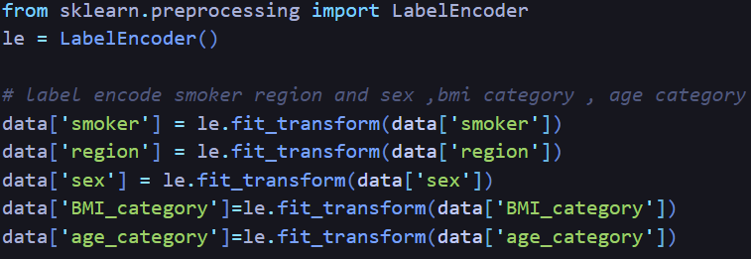
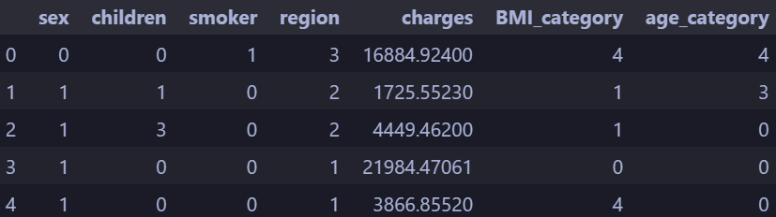
Feature Encoding

Slide 11
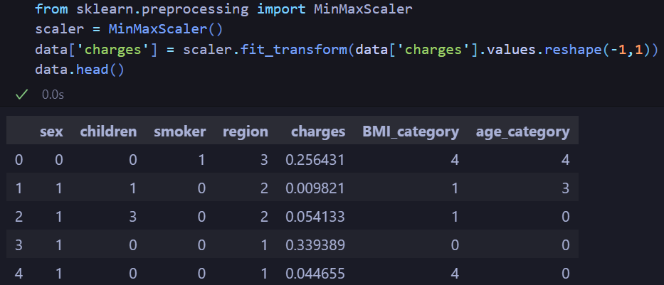
Feature Scaling

Slide 12
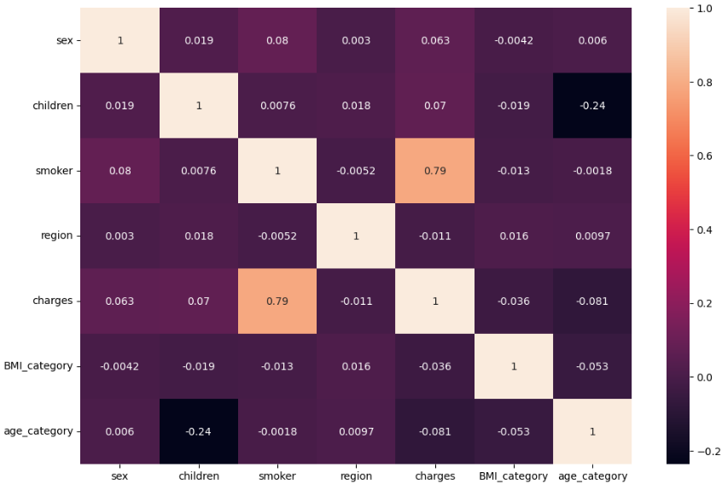
Multicollinearity Check
No any highly correlated features are present

Slide 13
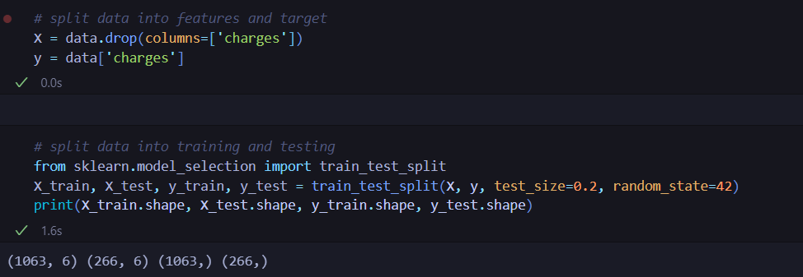
Splitting the Dataset

Slide 14
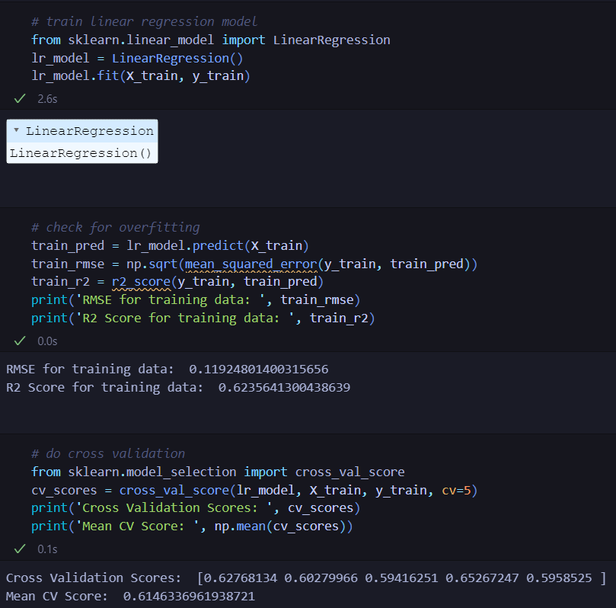
Model Training - Linear Regression

Slide 15
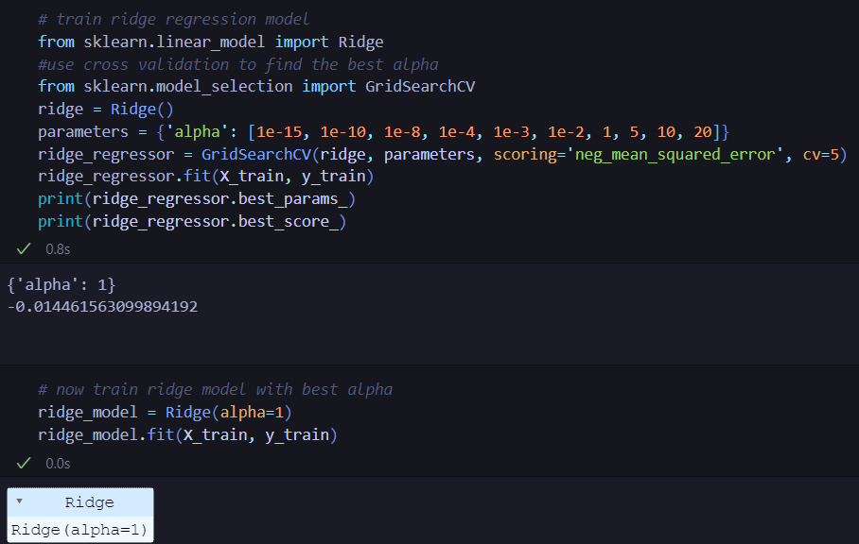
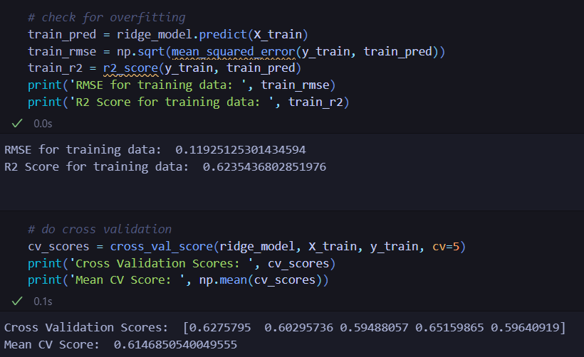
Model Training - Ridge Regression

Slide 16
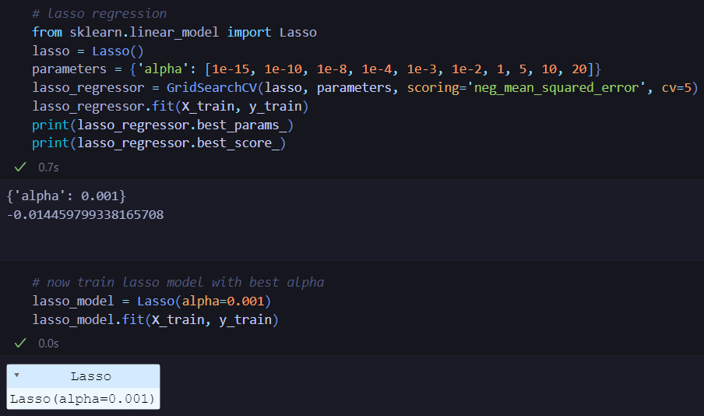
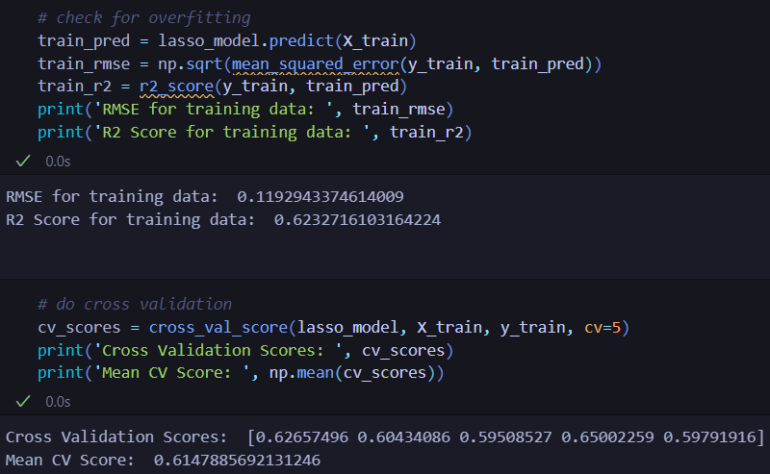
Model Training - Lasso Regression

Slide 17
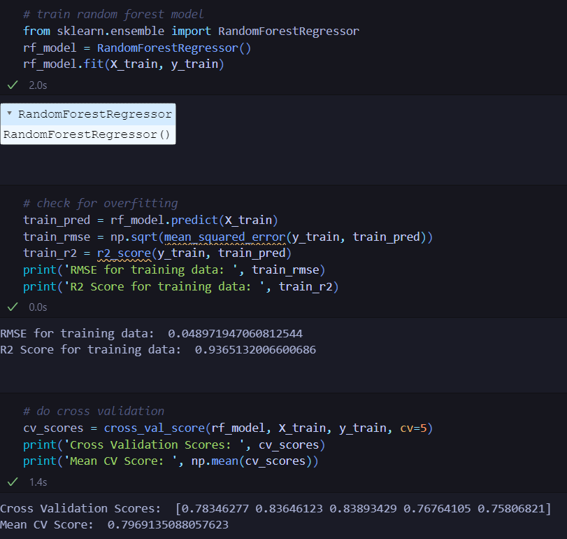
Model Training - Random Forest Model

Slide 18
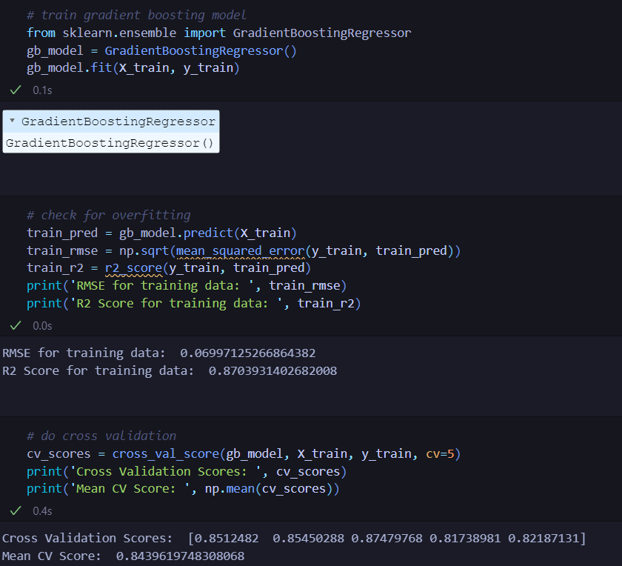
Model Training - GB regressor Model

Slide 19
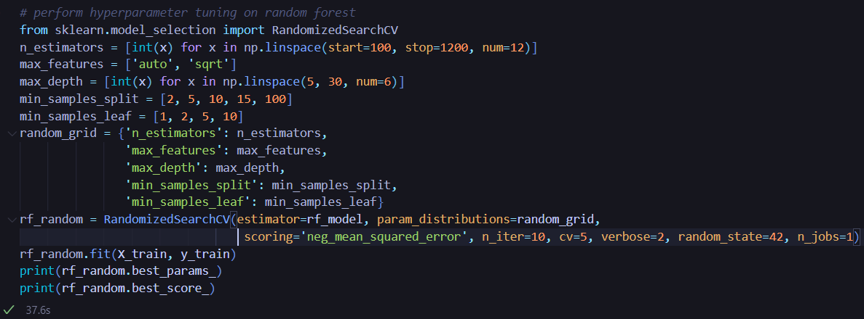
Hyperparameter Tuning
Random forest Model gives best R2 score so we will do hyperparameter tuning on it

Slide 20
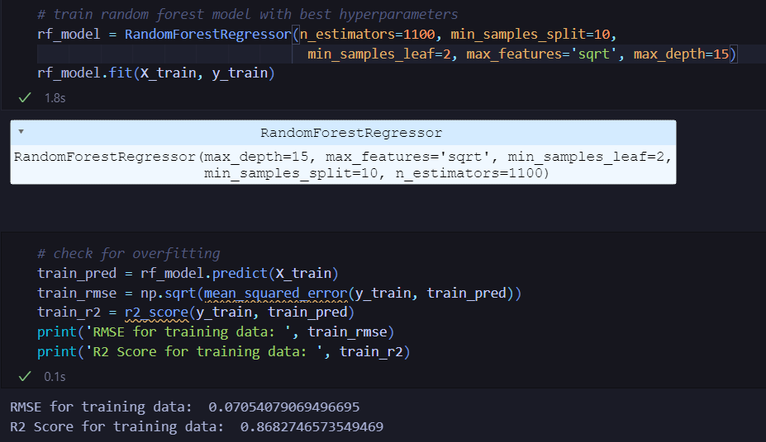
Hyperparameter Tuning

Slide 21
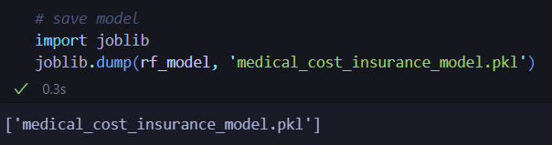
Saving the Model

